Slide 1
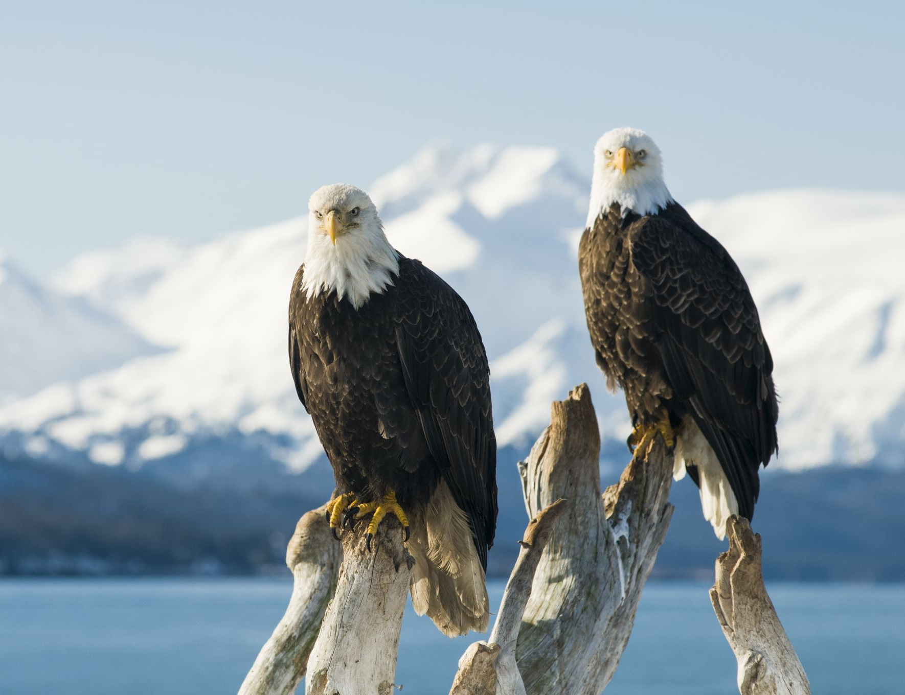

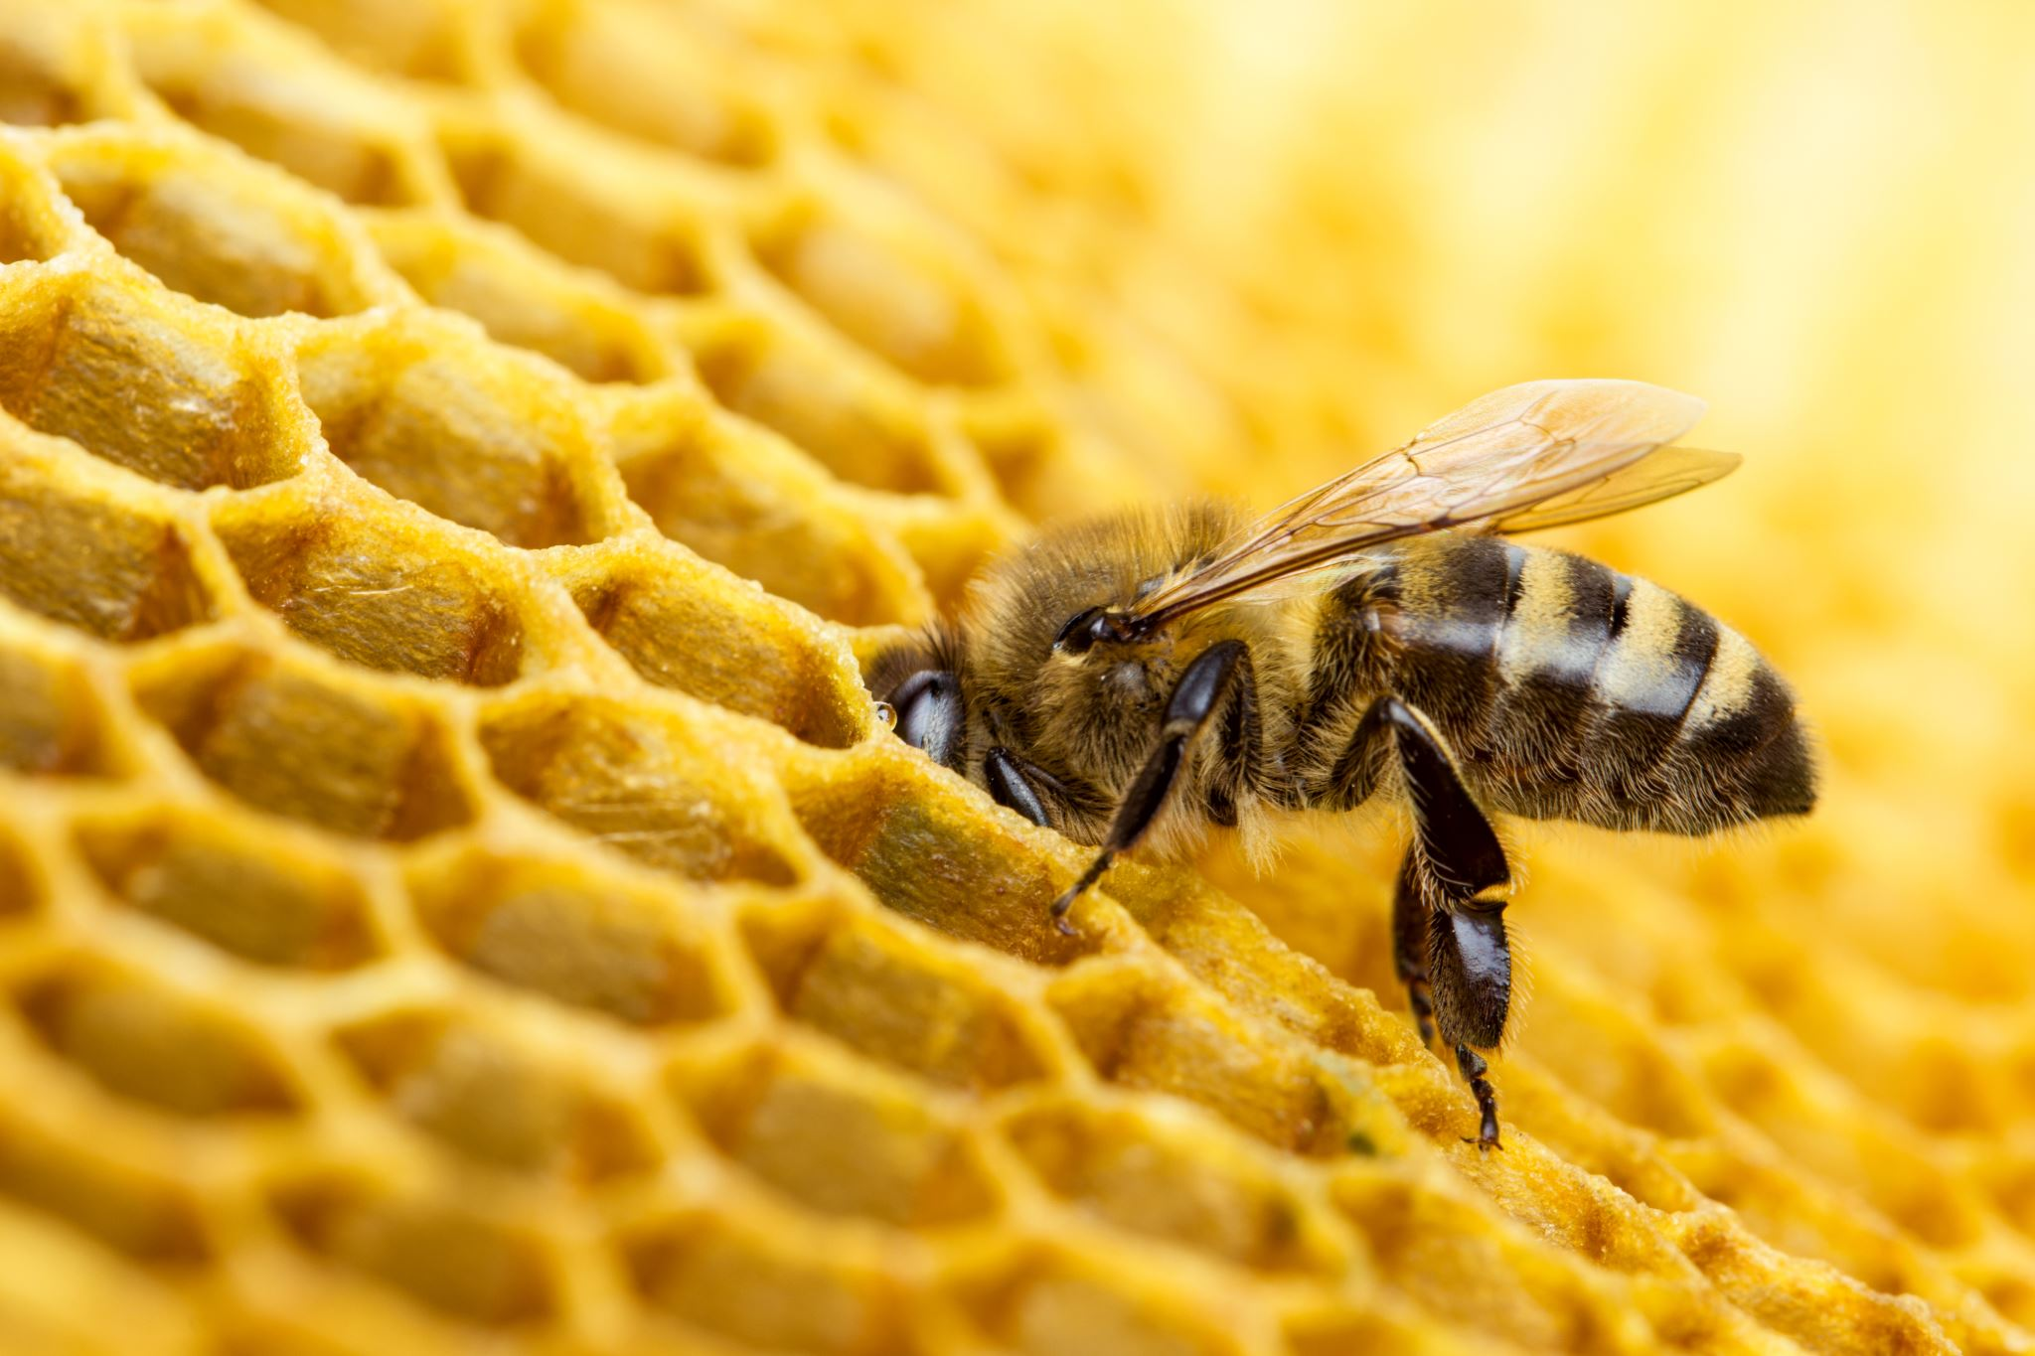
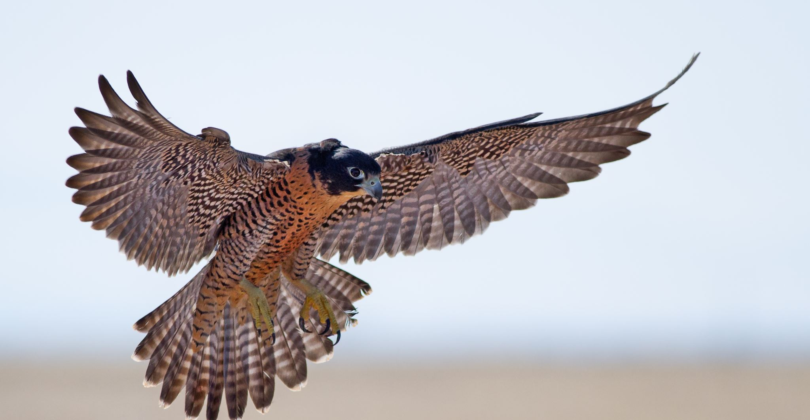
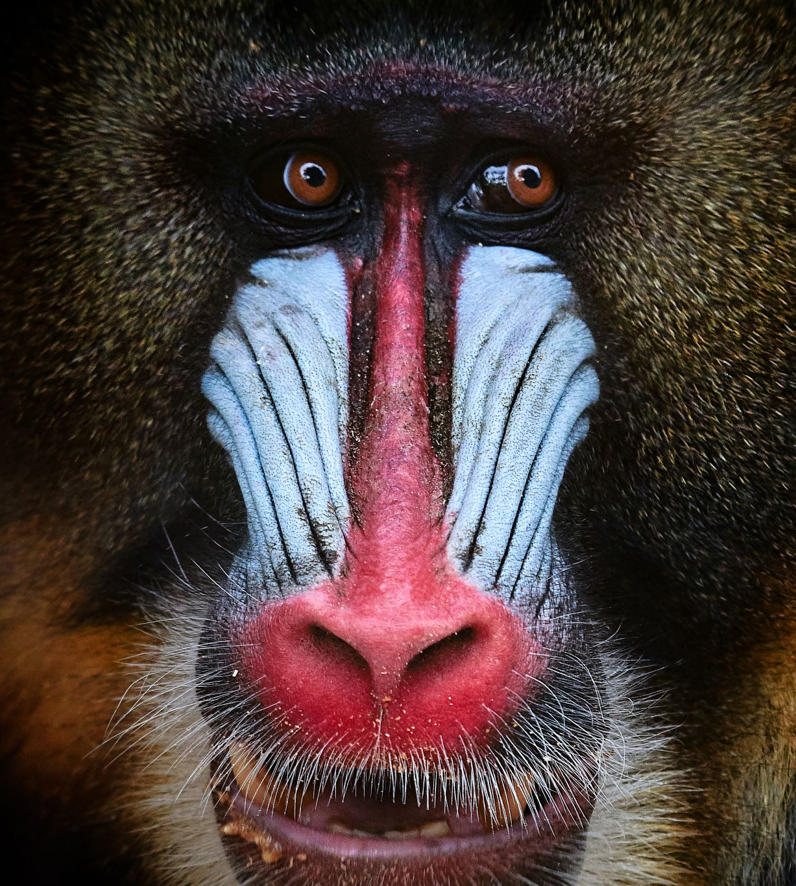

Environmental
Science
Class
C. King

Slide 2




Expectations
Digital days are not “free” days. Digital days are to work on Canvas assignments.
Both face-to-face and digital assignments count towards a student’s grade
Please check Infinite Campus for grades. Canvas gradebook is not an official gradebook that we use. Only Infinite Campus is used for official grade reporting. So that means that grades in canvas do not count until they are posted in IC.

Slide 3






Academic integrity – we are here to learn! We are here to prepare for the next grade level and to prepare for life. Students need to learn the habits of successful people, which include integrity and work ethics. – In other words please do your own work ! It is very easy to see when a student is sharing information with other students.
We work hard designing and planning rigorous and focused curriculum, instruction, and assessment. We expect students to do their part and work hard! We want our students to be successful. We will work together to achieve that goal!

Slide 4
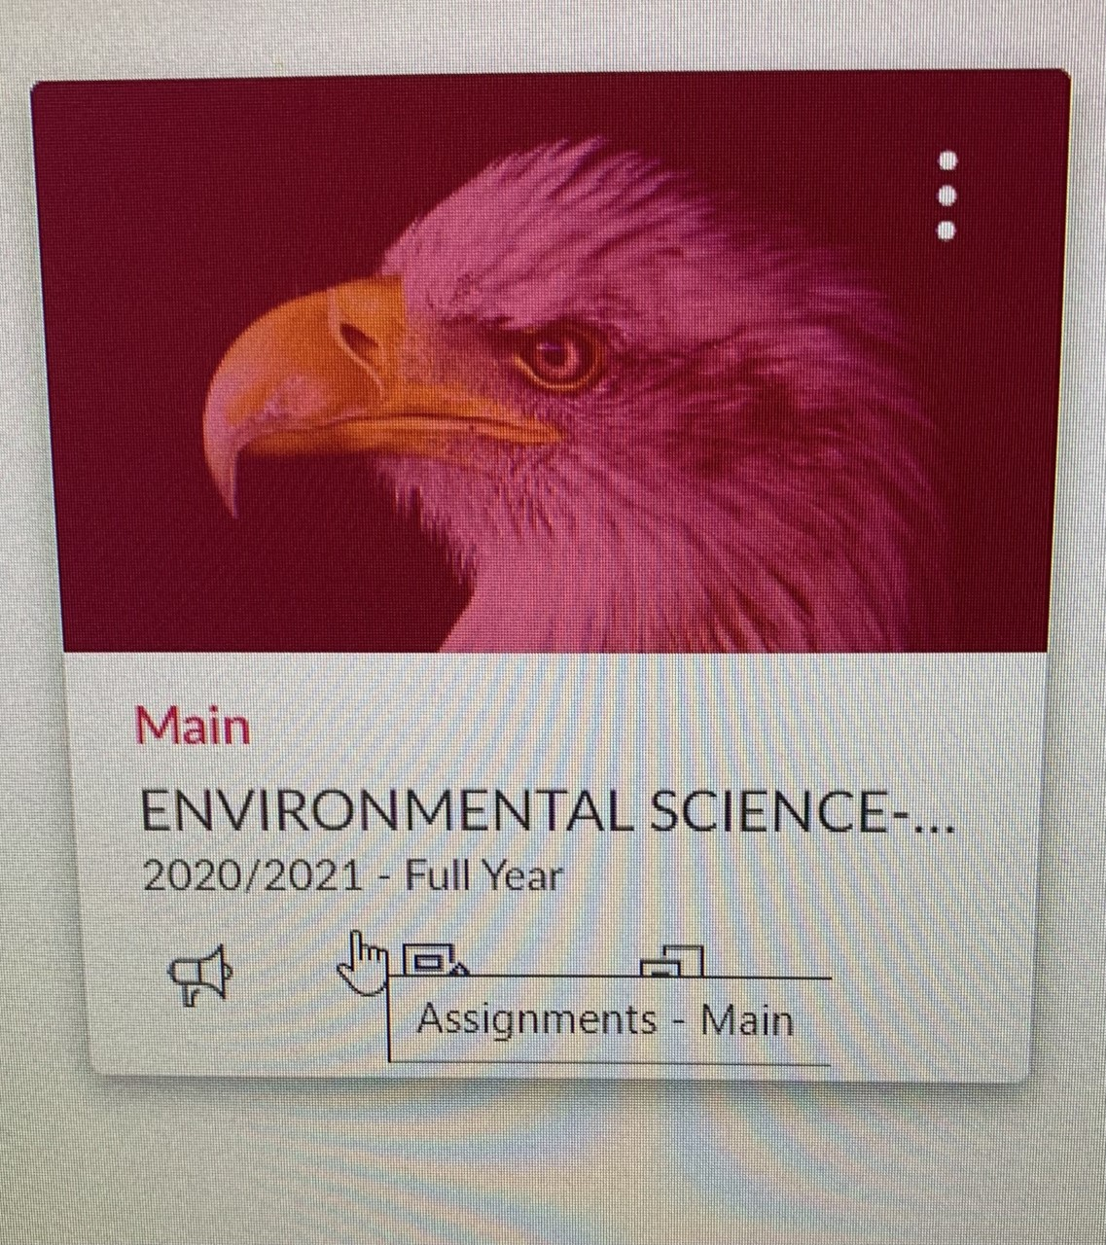
Environmental Science Canvas Page
All environmental students are enrolled in the same canvas course which looks like

Slide 5
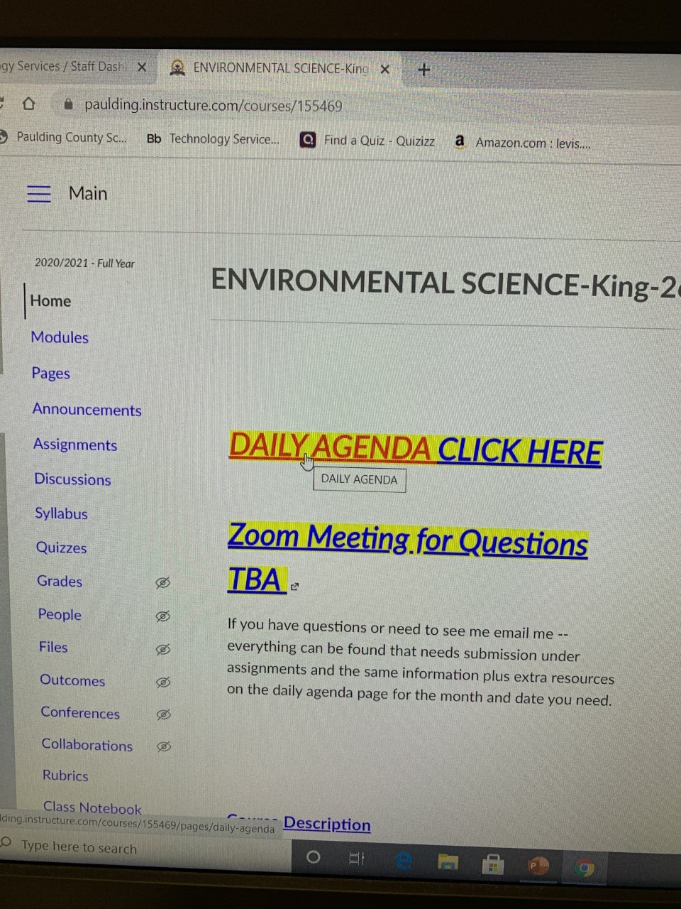
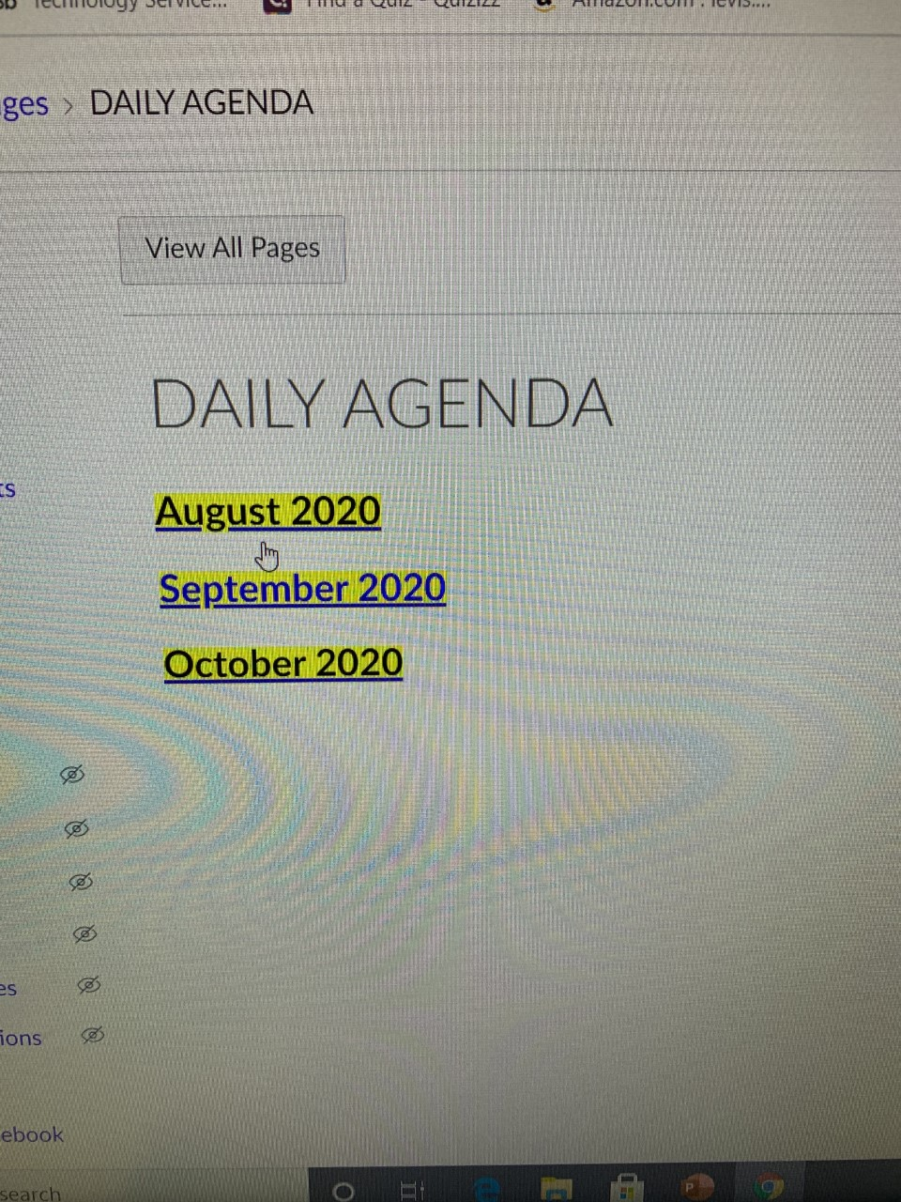
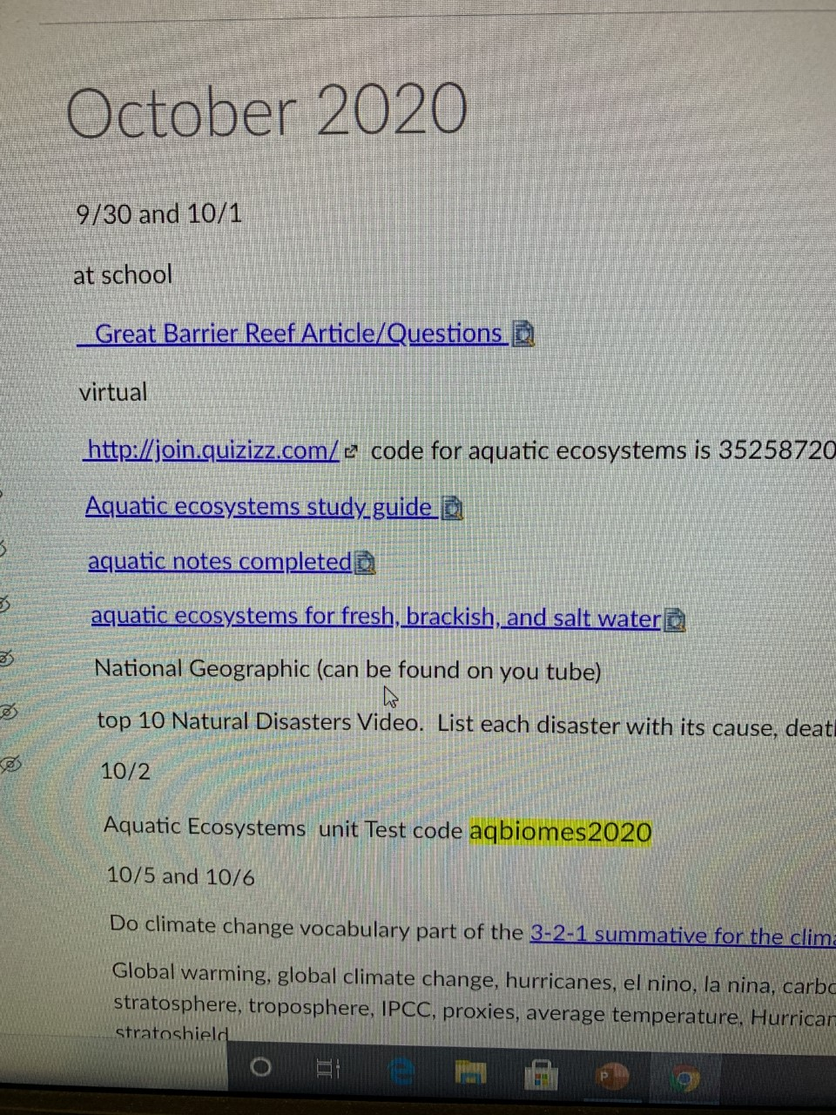
After logging into this course you are taken immediately to the
Home Page
Every assignment for every day is listed on the month we are in at the time and all previous assignments are listed on their days from the first day to the present. Like the
October Page
As you can see there is a link which takes you to the
Daily Agenda Page -

Slide 6
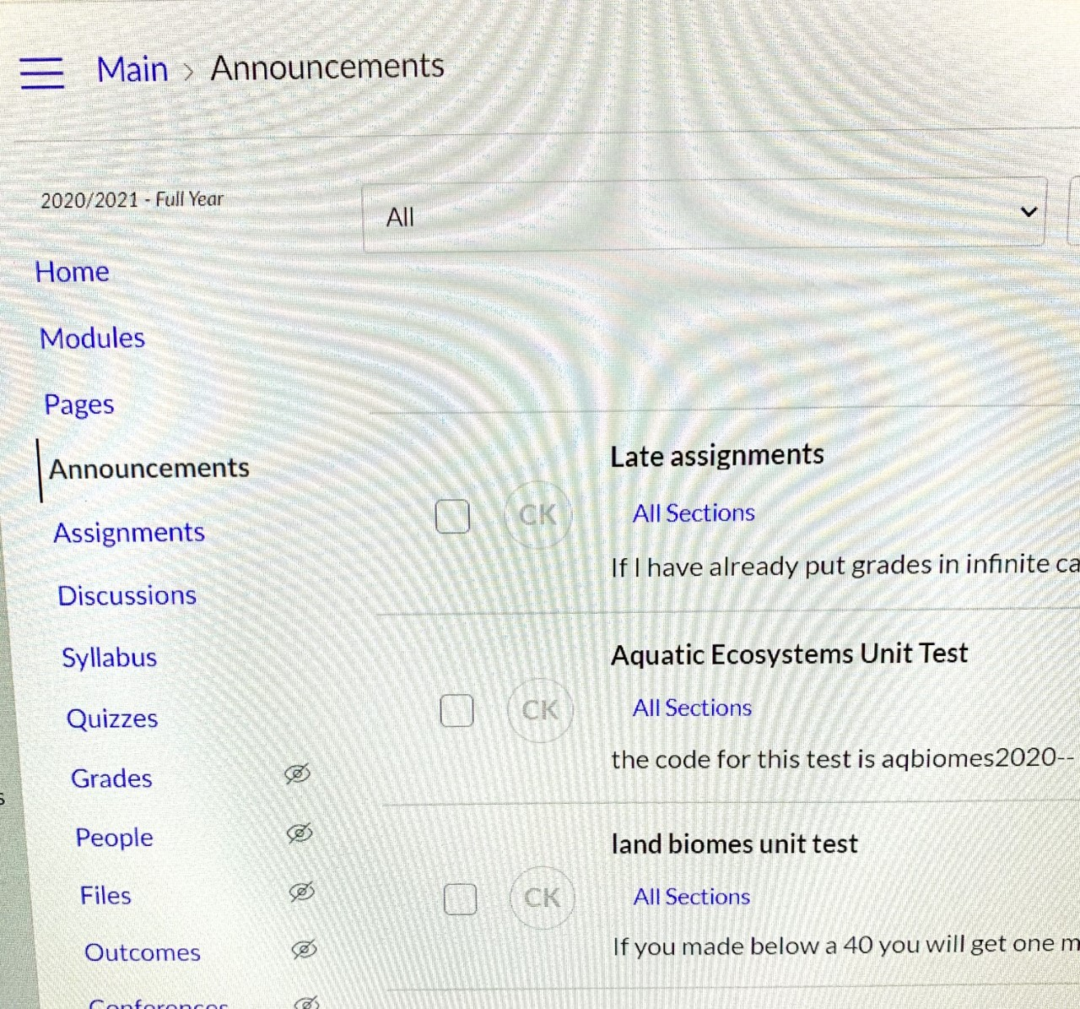
Announcements
I will always send out various announcements and reminders to my students. Test codes, extra instructions, repeated answers to questions already asked and answered, and general comments and opinions. I will try to also emphasize praise to those who deserve it though I give praise only when it is deserved. I am very straightforward and truthful. Don’t ask a question you do not want answered truthfully. My expectations are high therefore my praise must be earned.

Slide 7
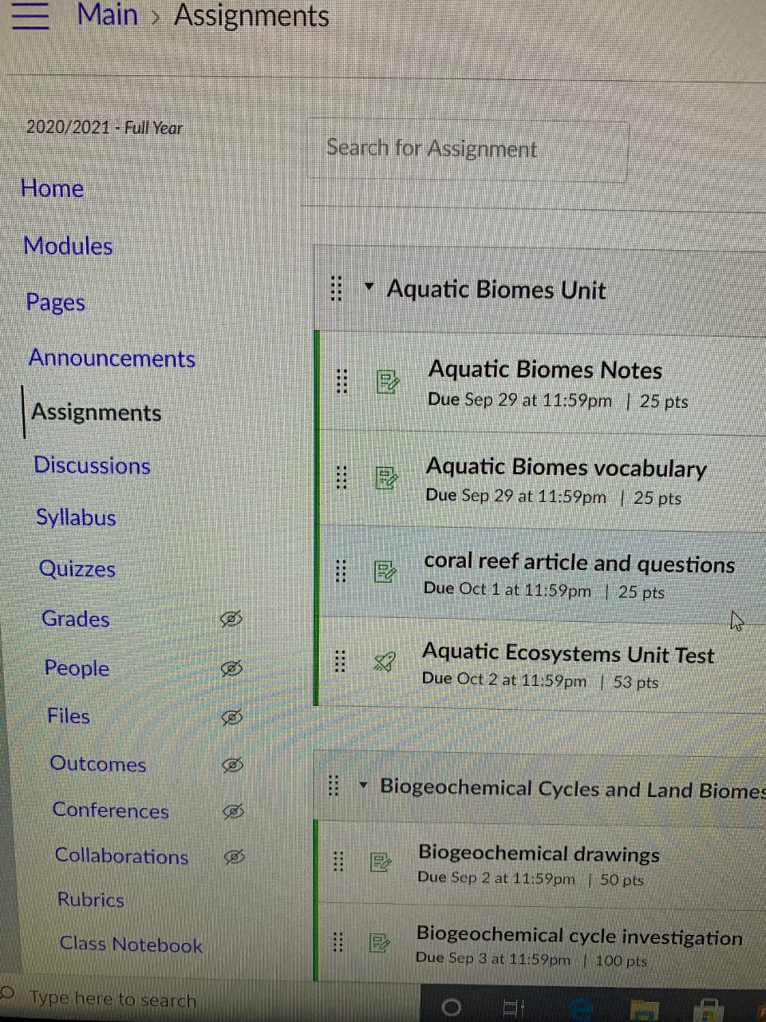
Assignments
All students will submit files or pictures of assignments in the assignments area. The assignment will be listed with a due date and a submission button.

Slide 8
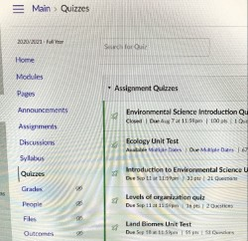
Assessments
Quizzes and unit tests will be given on Fridays virtually when on the Hybrid Schedule to ensure maximum instructional time is utilized during face to face time. Lectures, discussions, labs, facilitated learning , and reviews will be emphasized in the environmental science classroom.
Students can get to their unit tests or quiz under the quizzes section. The needed codes will be given in both the announcement and the daily agenda sections of the canvas course.

Slide 9
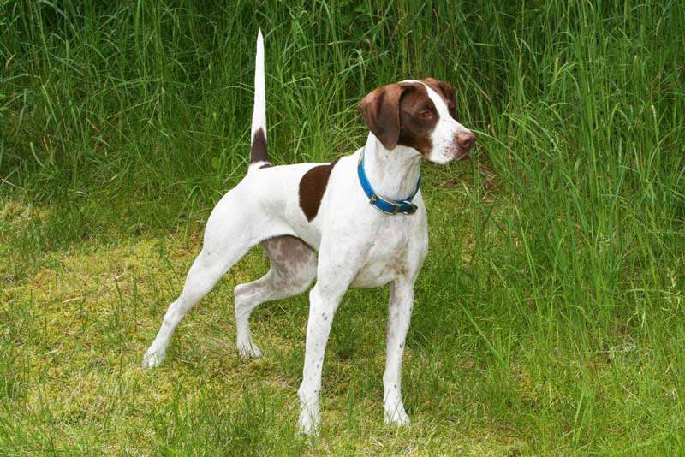

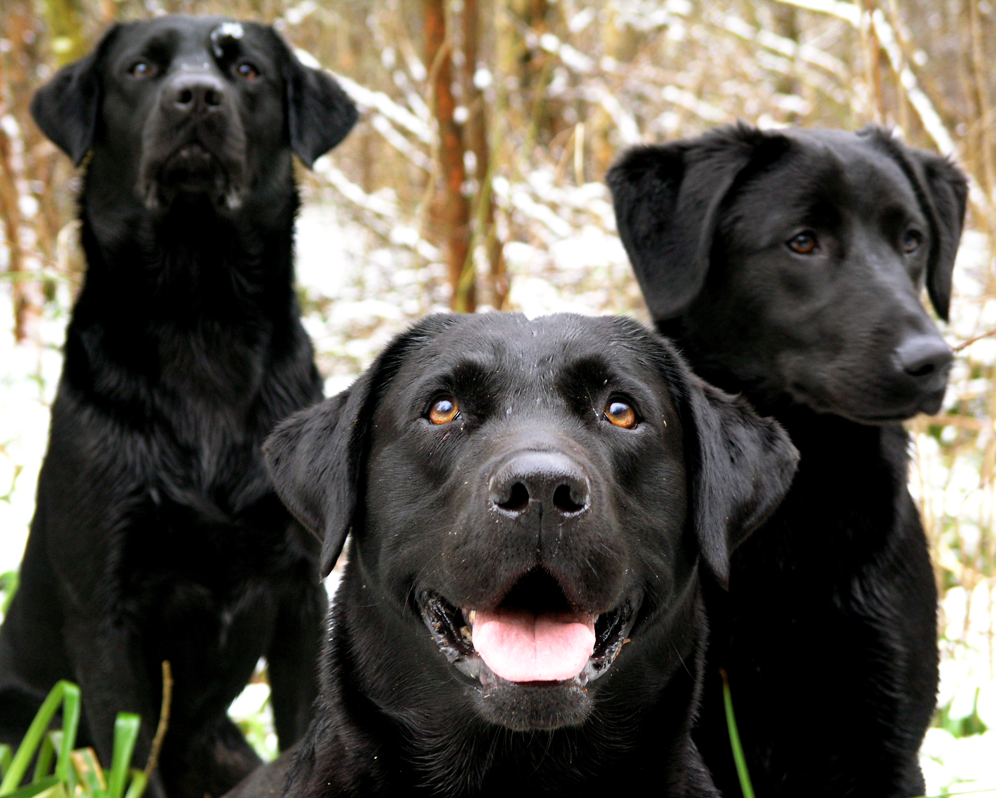
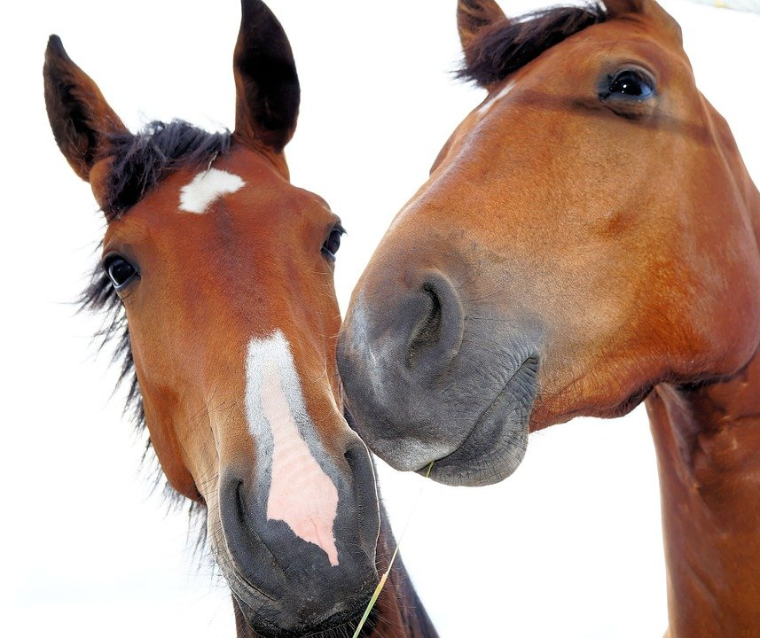

Tutoring/help sessions
I will set up zoom sessions and offer face to face sessions on Fridays. Zoom meetings will be announced on the home page and face to face meetings can be scheduled. We have all our meetings and extra sessions on Fridays so I will work around them. A student may email me at any time and expect an answer in a timely manner. Email comes straight to my phone and watch so I will get to them as quickly as possible. I do have a 6-year-old child , 5 horses, bird dogs and labs, and a husband who require my attention as well, but my students can rely on me for help when needed. I have been teaching for 31 years and these are truly strange times, but we can be successful if we work together .

Slide 10
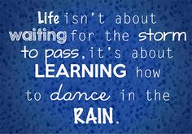
Tips for parents/guardians to help students to stay organized and manage their time wisely during the digital days
Set a daily schedule for your student for digital days (when to get up, when to start working, how much time to allocate per each class on the schedule, etc.). Allow at least one hour per class.
Include breaks in the schedule as well as lunch and snack-time.
Have students use either calendar on their phone or a planner to keep up with their due dates and assignments.
Follow up with the students at the end of the day and ask them what they have completed.
Call a counselor at the school to help set you up as an observer in canvas and you will also see the entire course.
This Photo by Unknown Author is licensed under CC BY-NC-ND

